Slide 1
CREDIT SCORING MODEL
A credit scoring algorithm that predicts the chance of a given loan applicant defaulting on loan repayment.

Slide 2
Table of Contents
Data Preparation.
Understanding our Data(Explore the data).
Variable Distribution.
Data Imputation(Variable Manipulation).
Feature Transformation.
Model Structuring with Logistic Regression Algorithm.
Confusion Matrix
Confusion matrix In Action
Threshold Application and Performance Visualization.
Performance Visualization
Conclusion.

Slide 3
Data Preparation.
Aspects to consider on data preparation:
~ Pandas Python Library.
~ Matplotlib Python Library.
Make sure Pandas Python Library and Matplotlib Python Library is installed on the machine!
What we do here!
Read the csv data
After reads, We get the data in form of pandas dataframe

Slide 4
Understanding our Data
- To understand our data we have to get some information from our data.
- To do this, helps us to get an idea on what to do next on our data so as to make sure the model runs on the data smoothly and efficiently with minimal errors.
- This stage helps us to know refinement procedures to take on our data.
Explore our data to know of:
Shape
Data description
Columns
Rows
Information

Slide 5
Variable Distribution.
Counting values as per the Variables.
Helps us in the process of data splitting.
In our case:
No anomalies in the data
Some data has null values, for example DEBTINC variable
Nominal features exists which needs modification for usage with logistic regression
High Skewing on feature YOJ
Discover some other features if you need to...

Slide 6
Data Imputation
Data Manipulation.
This is the refinement of our data.
After refining our data, we get the imputed dataframe.
This stage helps us to replace values with some data values. If null, fill with a value
This processing of the data Helps our data to be uniform and not to be NaN.
Impute the data as per your need. Imputation not limited.

Slide 7
Feature Transformation
Feature transformation, Feature selection.
Transformation is all about changing the original values and replacing with a different value.
Some processes that may take in this stage can be:
- Cap off some features
- Create new binary variables
- Convert the nominal features, JOB & REASON into usable form and remove them from the data table
- Distort assymetric distribution of the feature YOJ,For that we can apply log of YOJ

Slide 8
Model Structuring
Create the model.
What to consider when creating our model.
~ sklearn python library.
- make sure sklearn python library is installed.
What three Model aspects to look into here:
~ Data Spliting, that is, train data and test data.
~ Fitting of our train data. Running a fit() function from the logistic regression model algorithm instance.
~ Prediction. Where prediction is done. You just pass the predict() function from the logistic regression model algorithm instance.

Slide 9
Confusion Matrix
Well, The performance of a model, any model, is determined or costed on how the data is processed and fed to the model.
Performance can be affected by many things or processes. The processes maybe, you have done or not.
Common processes done in this case as seen in the previous walk-through, Is enough to measure how the model adapts to efficiency.
This is where Confusion matrix is required to take its course.
This function helps in measuring the performance of our model
It helps us in this case, doing some comparison of the actual values to the predicted values(Y predictions in our case). Sklearn metrics helps us in getting the performance values of our model.
That is, accuracy, precision and other values you need.
But this does not solve our performance issue. In this case, We are needed to find other ways of increasing efficiency(accuracy).

Slide 10
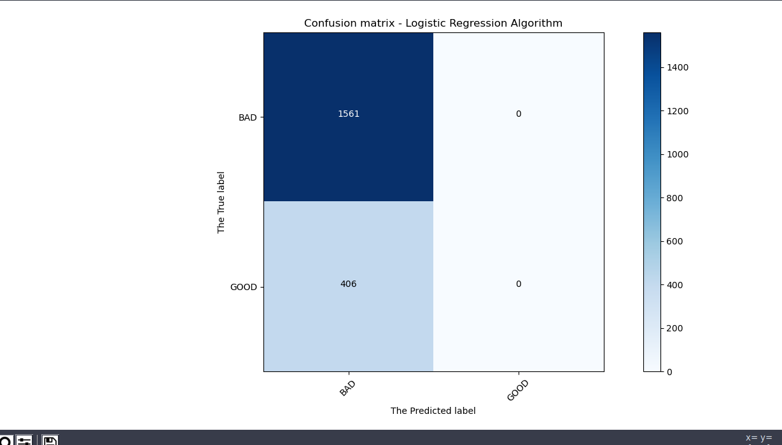
Confusion matrix In Action...

Slide 11
Threshold Application and Performance Visualization.
Threshold and performance visualization helps in increasing our model accuracy and efficiency as well.
Applying a threshold, Logistic regression does one thing, Assigns one row a probability of bring true and then predicts for each row where the probability is greater than or equal to 0.5. By default, 0.5 is always applied.
So, Setting a different threshold value, increases or lowers the model’s accuracy and efficiency.
The higher the threshold the higher the accuracy and vice-versa.

Slide 12
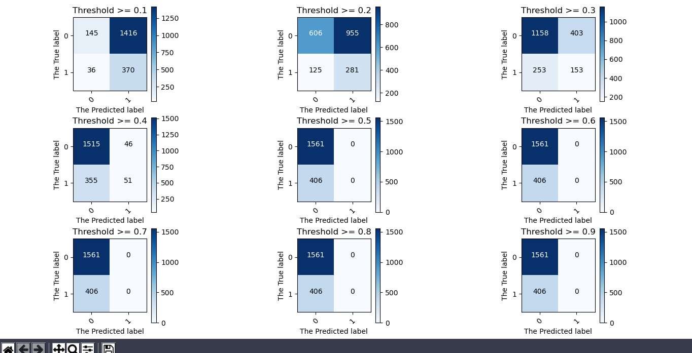
Performance Visualization

Slide 13
Conclusion.
Data refinement should be as perfect indeed.
The recall values and accuracy values changes with change in threshold changes.
Based on your need, Required accuracy, You have to select what threshold value to use.
By default, 0.5 threshold value should be used. And general predictions, 0.5 is highly recommended for use.

Slide 14
~ END ~

